Slide 1
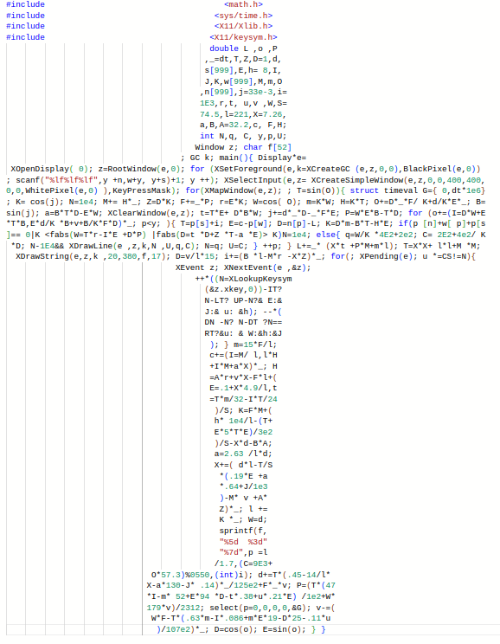

THE QUIRKS OF C
Or how to write dirty C ?
Thomas Sayen

Slide 2
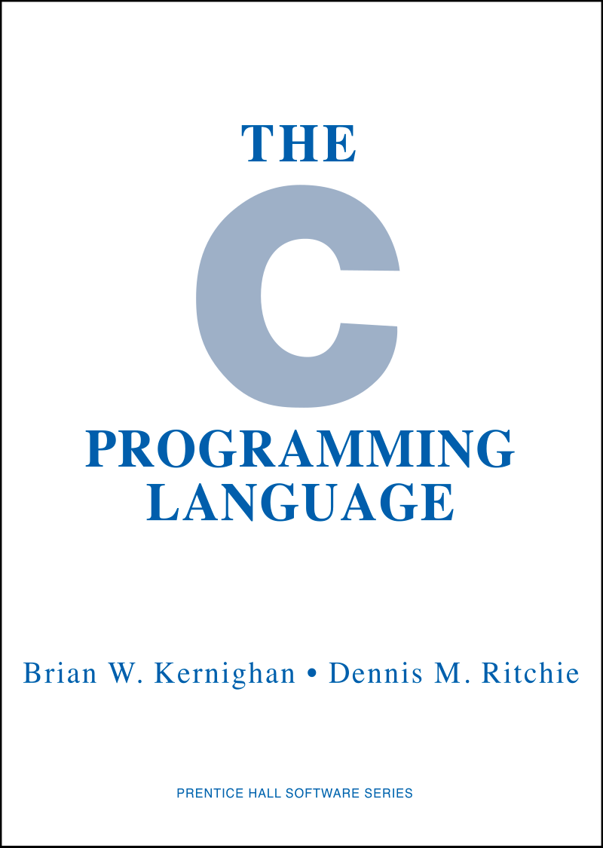
A SIMPLIFIED HISTORY OF C
C is created by Dennis Ritchie
Standardisation of C, C89 (aka ANSI C) becomes the very first official standard.
Minor changes and additions.
1972
1983 → 1989 - ANSI & ISO (1990)
2011 (C11) - 2018 (C17 or C18)
Significant language modernisation (removing old stuff) and importing some C++ ideas (nullptr / constexpr), experimental today (February 2025)
1978 - K&R
1999
Unofficial C standard. A book co-authored by Ritchie et Brian Kernighan, hence K&R.
C99 : Second C standard. Most used standard, as it’s supported by ~100% of devices, and additions since C89.
2023 (C23)
Blog article about K&R

Slide 3
WHICH VERSION ?
To this day (March 2025) :
C89 | C99 | C11 | C17 | C23
Extremely portable | Extremely portable + many additions | Added (among others) multithreading | Bug fixes | More modern but experimental
Cheat sheet C11→C23
Default standard of GCC 14.2.0 and Clang 19.1.0
How to detect the C standard used to compile our code ?
C23 being still experimental, GCC 14.2.0 hasn’t updated __STDC_VERSION__ yet.
IBM I only supports up to C99
(§ Industry Standards)

Slide 4
USEFUL EXAMPLES

Slide 5

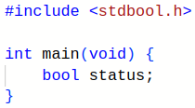


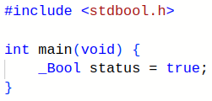
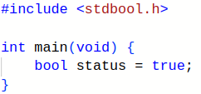


BOOLEANS
C89 : →no boolean type ! →int often used instead | Since C99 : §7.16 →bool, true, false = macros →_Bool = keyword (§A.1.2) | Since C23 : §6.4.2 →bool, true, false = keywords →_Bool = keyword

Slide 6
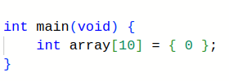

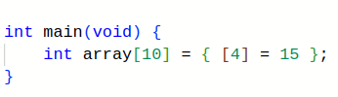



INITIALIZE THE N-TH ELEMENT
C99 §6.7.8/6

Slide 7
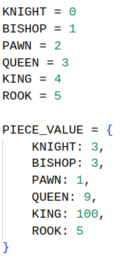
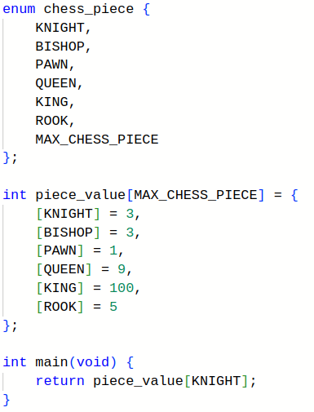
A MAP/DICTIONARY IN C99
C99
Python 3 (dictionary)

Slide 8
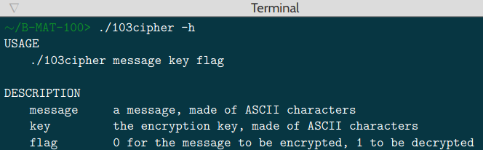
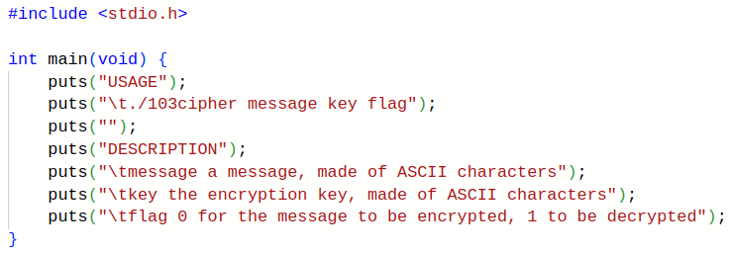
--HELP

Slide 9
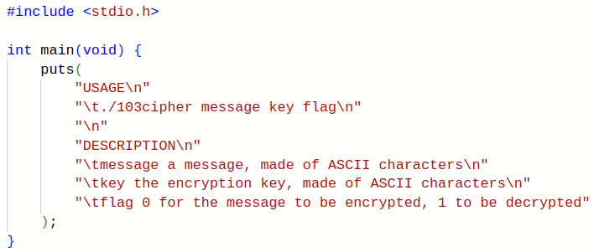
--HELP
C89 §6.1.4 (Example)
C99 §6.4.5/7

Slide 10
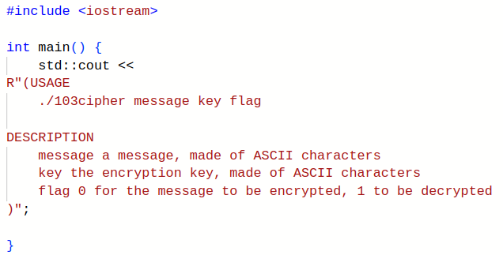
--HELP (C++)
Cppreference, “Raw string literal” section

Slide 11
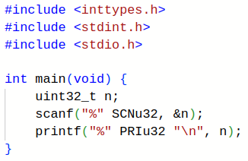
#include <inttypes.h>
uint32_t = unsigned char ? ⇒ %hhu
= unsigned short ? ⇒ %hu
= unsigned ? ⇒ %u
= unsigned long ? ⇒ %lu
= unsigned long long ? ⇒ %llu
PRIu32 / SCNu32 → correct flag for printf/scanf
“%” “u” → “%u”
C99 §7.8.1

Slide 12
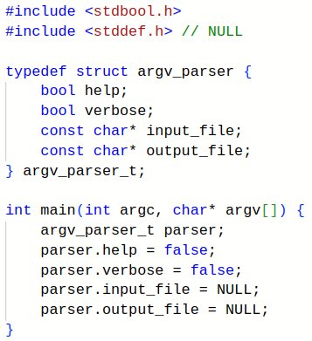
A SIMPLE PARSER
./a.out [-h] [-v] input [-o output]
]
Uninitialized structure
Then we initialize each field

Slide 13
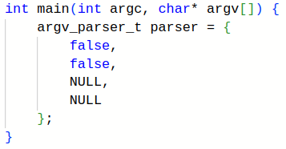
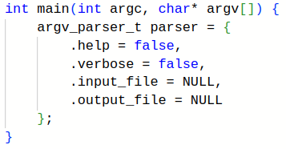
A SIMPLE PARSER
Everything is directly initialized, but not much readable (which false corresponds to which field ?)
Everything is directly initialized and it’s readable, we explicitly write the name of each field and its value.
C99 §6.7.8/7 (designated initializer)

Slide 14
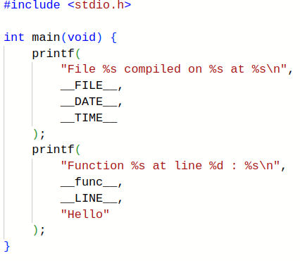
MACROS & PREDEFINED IDENTIFIERS
__FILE__ (macro) :
→ string literal (in double quotes “”) containing file name
__DATE__* & __TIME__* (macros) :
→ hour and date where the file has been compiled
__func__ (const char []):
→ name of the function where we currently are
__LINE__ (macro) :
→ number of the line where we currently are
C89 §6.8.8 // C99 §6.10.8 (macros)
C99 §6.4.2.2 (__func__ only)
* __DATE__, __TIME__ and locales

Slide 15
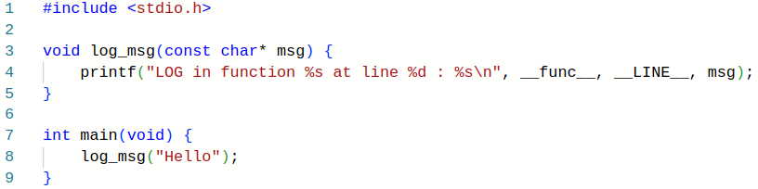
LOG FUNCTION
We call the function and move there
LOG in function log_msg at line 4 : Hello

Slide 16
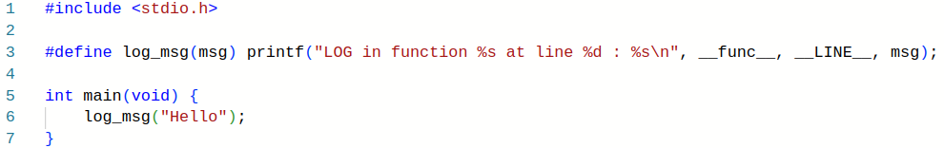
RATHER A LOG MACRO
The macro has been pasted by the preprocessor, we don’t move
LOG in function main at line 6 : Hello

Slide 17
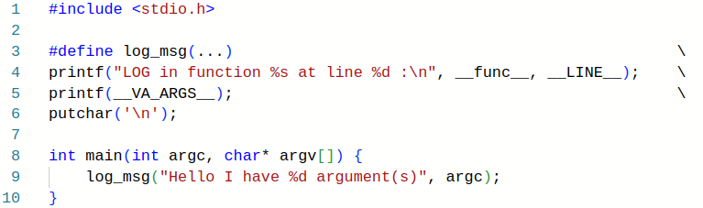
LOG MACRO - A BIT OF VARIADIC
Variadic macro, C99 §6.10.3/10
C99 §6.10.3/5, §6.10.3.1/2
./a.out helloworld
→ LOG in function main at line 9 : Hello I have 2 argument(s)

Slide 18
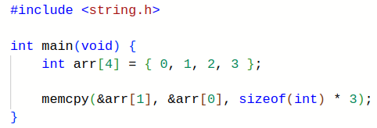
IS MEMCPY… UNDEFINED ?
How to move elements in an array ?
Before : { 0, 1, 2, 3 }
After : { 0, 0, 1, 2 }
Undefined behavior !
Behavior of memcpy on 6 different compilers
C89 §7.11.2.1 (Description)
C99 §7.21.2.1/2

Slide 19
MEMMOVE TO THE RESCUE
man (3) memcpy :
DESCRIPTION
The memcpy() function copies n bytes from memory area src to memory area dest.
The memory areas must not overlap. Use memmove(3) if the memory areas do overlap.
0 | 1 | 2 | 3
Destination
Elements to copy
Overlap !

Slide 20
WHY MEMMOVE ?
Summary of C99 Rationale §7.21.2, about copy functions :
A copy function must work even if memory areas are overlapping
A copy function must be fast (and efficiently use hardware)
Contradiction ⇒ handling overlap degrades performances
→ memcpy for the speed (doesn’t handle overlap)
→ memmove for the feature (handles overlap)

Slide 21
RESTRICT POINTERS
C89 §7.11.2.1
C99 §7.21.2.1
A restrict pointer must be the only one to access its memory area !
→ Otherwise it’s undefined behavior
C99 §6.7.3/7, §6.7.3.1
Goal: optimization !
To go further :
StackOverflow
Wikipedia

Slide 22
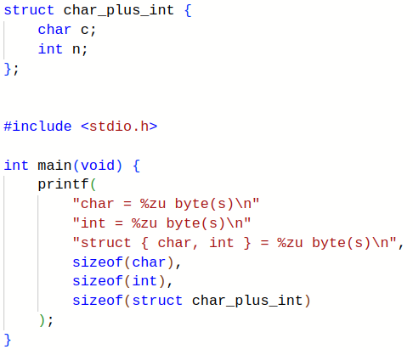
SIZEOF(STRUCT) AND MATHS…
char = 1 byte(s) *
int = 4 byte(s) *
struct = 8 byte(s) *
Then 1 + 4 = 8 ?
* According to the system

Slide 23
MEMORY ALIGNMENT
{
Out of the structure
We expect our structure to take 5 bytes :
Address | 0 | 1 | 2 | 3 | 4 | 5 | 6 | 7
Content | char | int | int | int | int | …. | … | …

Slide 24
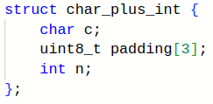
MEMORY ALIGNMENT
Actually, the structure takes 8 bytes :
int = 4 bytes, must* be 4 bytes-aligned.
⇒ Stored at an address being a multiple of 4
There are keywords to change/know the alignment.
{
Address | 0 | 1 | 2 | 3 | 4 | 5 | 6 | 7
Content | char | padding | padding | padding | int | int | int | int
3 padding bytes between the char and the int, to shift the int.
They’re inserted by the compiler.
* For more details

Slide 25
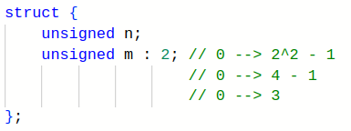
BIT FIELDS
bit field, bit-fields and bitfields spellings exist.
n is a regular field.
m is a bit field, precisely 2 bits-wide.
m is a 2-bits truncated unsigned, instead of the usual 32 or 64 bits
m can only store values from 0 to 3 *
Some restrictions are applied to bit fields, the main ones being :
We cannot take their address with & …
(C89 §6.5.2.1 footnote n°59, C99 §6.7.2.1, footnote n°103)
Nor get their size with sizeof
(C89 §6.3.3.4 (Constraints), C99 §6.5.3.4/1)
* m is unsigned, so overflow works as it was a regular unsigned, it wraps around 0. If m was signed instead, then the overflow would be an undefined behavior.
C89 §6.5.2.1, §6.7.2.1

Slide 26
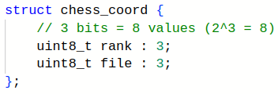
BIT FIELDS // <limits.h>
bit field, bit-fields and bitfields spellings exist.
Low-level usage, an amount of bits to :
Read (network protocols, binary decompression)
Write (binary compression, specific embedded systems)
Needed for the code to work
Specific application, some data maximum value is fixed and known :
Here, coordinates in chess (maximum 8)
Optimization (saves memory)
Minimum/maximum value of a type :
<limits.h> (C89 §5.2.4.2.1, C99 §5.2.4.2.1)
INT_MIN / INT_MAX
UINT_MIN / UINT_MAX
CHAR_MIN / CHAR_MAX
…

Slide 27
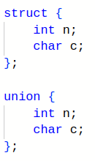
UNIONS
Structure :
Contains every field
Takes memory, but…
We can read and write in every field
Union :
Contains only one field at once
Saves memory
We can write in every field, but it overwrites the last written field
We can read every field, but only reading the field we just wrote into will return a relevant value
union + struct + bit fields = float (type-punning explicitly allowed in C but undefined in C++)

Slide 28
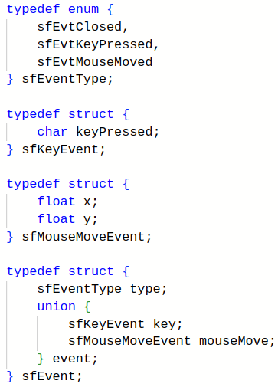
UNIONS - (C)SFML CASE STUDY
]
Event type
]
Here, the union contains the unique structure related to the event.
Structure for each event
]
The original sfEvent is directly an union and not a struct, as sfEventType is the 1st field and each event structure contains that sfEventType as its 1st field. Source : CSFML
Event structure, with a type and an union

Slide 29
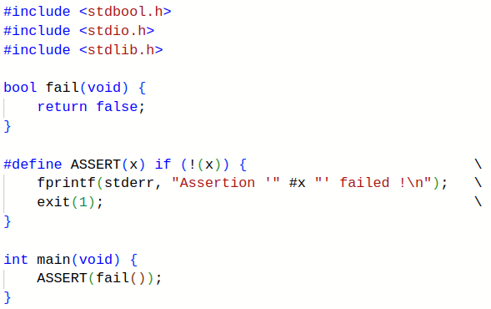
#MACRO
If x is fail()
→ #x is “fail()”
→ Useful for debugging
C89 §6.8.3.2
C99 §6.10.3.2

Slide 30
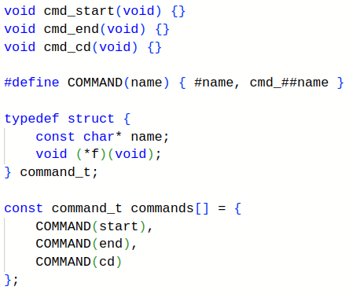
MACRO##MACRO
]
Functions for each command
{ “start”, cmd_start }
]
A command = a name and a function
C89 §6.8.3.3
C99 §6.10.3.3

Slide 31
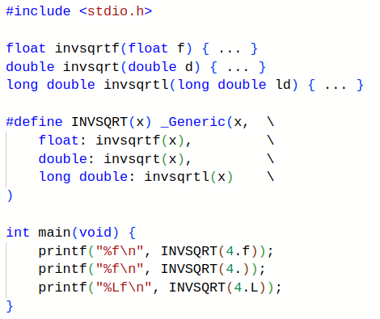
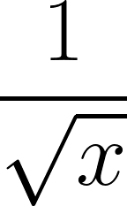
C11 - GENERIC MACROS
Specialized algorithm according to floating point type
Invsqrt
#include <tgmath.h>
C99 §7.22
C11 §6.5.1.1
Maths functions are usually unreadable... I mean optimized.
To go further

Slide 32
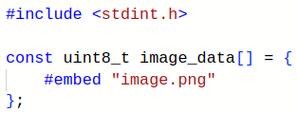
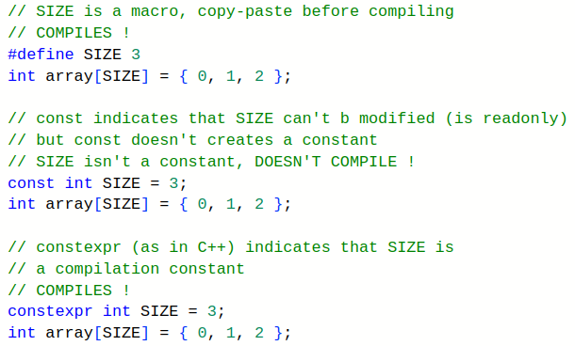

C23 - THE MODERNIZATION
Complete recap on cppreference
constexpr
Including a binary file
Bit-precise integers (no cppreference page yet)

Slide 33
THE QUIRKS

Slide 34
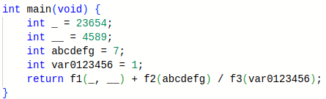
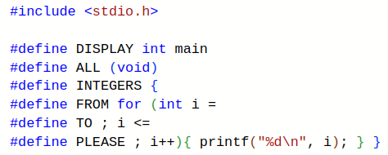
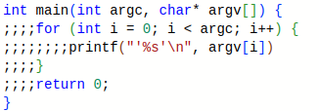
CLASSICS
One liner
Unreadable variables
Preprocessor abuse
Dubious indentation

Slide 35
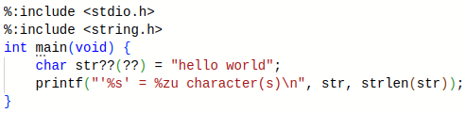

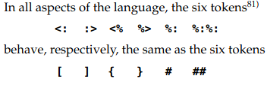
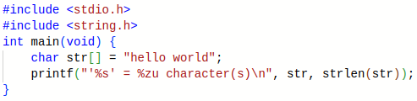
DI/TRIGRAPHS
Trigraphs, C89 §5.2.1.1, C99 §5.2.1.1
Digraphs, C95 §6, C99 §6.4.6/3
Trigraphs are removed in C++17 and C23 ! To go further →N4210 (C++) N2940 (C)

Slide 36
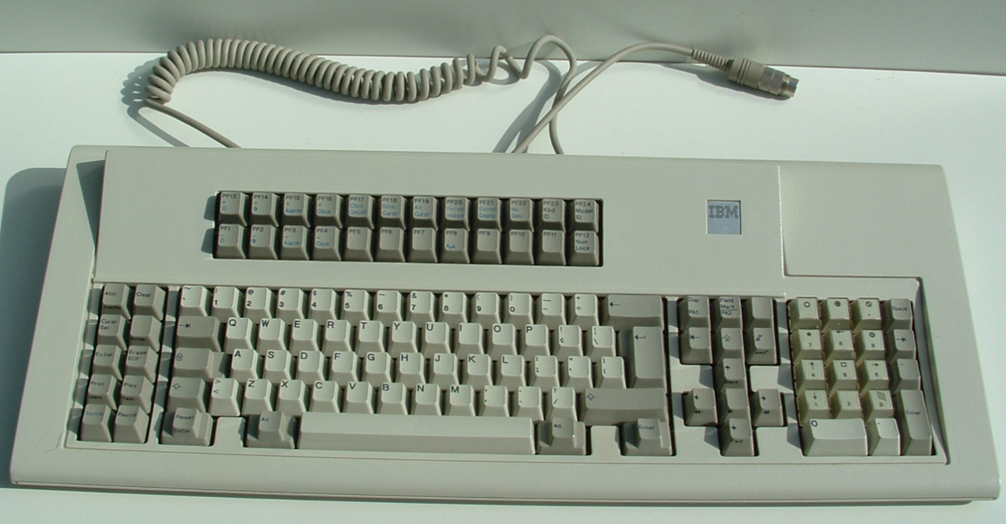
DI/TRIGRAPHS
Trigraphs, C89 §5.2.1.1, C99 §5.2.1.1
Digraphs, C95 §6, C99 §6.4.6/3
IBM Model M 1390572 keyboard without square brackets []
1986-1987? Wikipedia
Trigraphs removed in C++17 and C23 ! To go further →N4210 (C++) N2940 (C)

Slide 37



DI/TRIGRAPHS - TRAPS
Trigraphs = preprocessor
Digraphs = operators

Slide 38





DI/TRIGRAPHES - TRAPS
Trigraphs = PREPROCESSOR → replaced even in comments / strings

Slide 39
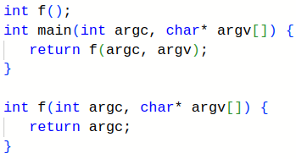
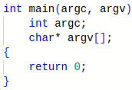

K&R FUNCTIONS
K&R Declaration / Prototype
K&R Definition
Valid but obsolescent !
C89 §6.9.4, §6.9.5
C99 §6.11.6, §6.11.7
C99 §Introduction/2
Removed in C23 ! N2432

Slide 40
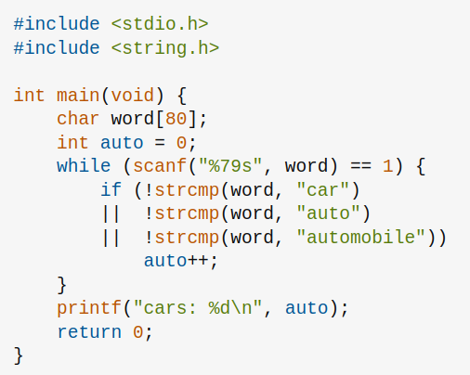
COUNTING CARS…
It doesn’t compile !
auto is a keyword !
Source : A question I asked about 'auto' on StackOverflow

Slide 41
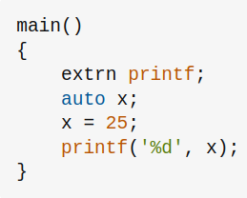
AUTO ? - A BIT OF B…
B (1969) →C (1972)
n is a variable stored in the stack, and has automatic storage.
auto exists in C for historical purposes and has been useless for a long time
Learning B
To go further → A question I asked about 'auto' on StackOverflow

Slide 42
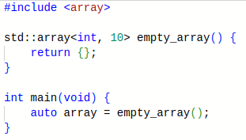
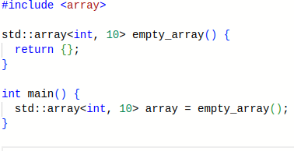
AUTO ? - A DIGRESSION IN C++ ?
C++11 : type inference
See on CppInsights
To go further:
auto (cppreference)
auto vs decltype (StackOverflow)

Slide 43

AUTO ? - AND IN C ?
C89→C17
C23
B
*
auto is the same as in B
auto is (almost*) the same as in C++
* B being only a transition language to C, it doesn’t have an official logo.
* auto in C is derived from the GNU extension __auto_type, less powerful than auto keyword in C++, here are some differences, and here too

Slide 44

INT ? - WHAT FOR ?
[
Compiles in C89 → implicit int
Invalid since C99
C89 §6.3.2.2 (Semantics, paragraph 2)
C89, §6.5.2 (Constraints, “or no type specifier”)
C99 §Foreword/5

Slide 45
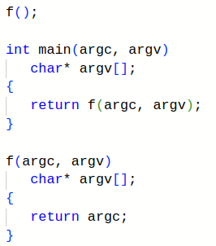
INT ? - WHAT FOR ?
f(void) declares a function :
Without any argument
Which returns an int
f() declares a function :
With an unknown number of arguments
Which returns an int
Even with -std=c89, GCC 14.2.0 and Clang 19.1 still emit warnings, as some of these features are nowadays deprecated and/or removed (but still perfectly valid in C89).
C89 §6.5.4.3 (Constraints, “An identifier list declares only…” + note 71)

Slide 46
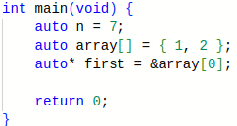
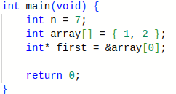
INT ? - WHAT FOR ?
Compiles in C89 → implicit int
Invalid since C99

Slide 47







DECLARE ME 2 POINTERS !
}
Correct !
ptr1 = int*
ptr2 = int !

Slide 48

DECLARE ME 2 POINTERS !
Short answer: the pointer * binds/applies to the variable name, not to its type.
StackOverflow
Long answer :
C89 §6.5, C99 §6.7
A declaration is made up of…
At least a specifier which is… :
A type (non pointer) and/or… // C89 §6.5.2, C99 §6.7.2
A storage class and/or… // C89 §6.5.1, C99 §6.7.1
A qualifier (const, …) and/or… // C89 §6.5.3, C99 §6.7.3
A function specifier (inline) // since C99, C99 §6.7.4
And potentially a declarator or a list of comma-separated declarators
A declarator : // C89 §6.5.4, C99 §6.7.5
An identifier (variable name) and potentially…
A pointer and/or
An array
etc..
Which could be initialized (= value) // C89 §6.5.7, C99 §6.7.8
int* ptr1, ptr2
→ type + pointer + identifier, identifier
Pointer + identifier = declarator
⇒ type + declarator, declarator
⇒ variable type*, variable type
ptr1 = int*
ptr2 = int !

Slide 49
A STRING IN SINGLE QUOTES ?
Char | ‘A’ | ‘B’ | ‘C’ | ‘\0’
ASCII | 0x41 | 0x42 | 0x43 | 0x00
Multiple characters in single quotes → an int with an implementation-defined value
Usually, ‘ABC’ = 0x414243
We often have 4 bytes-wide int and little-endian
‘ABC’ = 0x00434241 → “\0CBA”
C89 §6.1.3.4 (Semantics, “The value of an integer character constant containing more than one character [...] is implementation-defined.”)
C99 §6.4.4.4/10

Slide 50

A STRING IN SINGLE QUOTES ?
Displays hello!
- ‘lleh’ → ‘hell’
- ‘!o’ → ‘o!\0\0’
⇒ Thus “hello!\0\0”
Same behavior for 6 different compilers

Slide 51

A STRING IN SINGLE QUOTES ?
Using switch with multiple characters (up to 4 if an int is 4 bytes-wide).
Switch can only operate on integers (then no string) :
C89 §6.6.4.2 (Constraints)
C99 §6.8.4.2/1
Tested on the same 6 compilers
With nested switches

Slide 52

A STRING IN SINGLE QUOTES ?
Old debug method, when one must read a memory dump, we make the enum value more readable.
Program execution state
Source (StackOverflow)

Slide 53

(NOT) RETURN 0
 | C89 | C99 et +
Clang 19.1.0 | 0 | 0
GCC 14.2.0 | 5 | 0
Standard
Undefined* !
C89 §5.1.2.2.3
0 guaranteed
C99 §5.1.2.2.3/1
]
Compilateur
main() return code
No return
* undefined, thus it may change between executions

Slide 54


ARRAY OR POINTER ?
Implicit conversion of arrays into pointers
C89 §6.2.2.1 (paragraphe 3)
C99 §6.3.2.1/3
Implicit pointer
Same for “int array[]” !

Slide 55


A QUICK STROLL IN [BRACKETS]
[const] → qualifier on the implicit pointer C99 §6.7.5
Doesn’t compile !

Slide 56


A QUICK STROLL IN [BRACKETS]
[static n] → indicates the expected minimum size of the array C99 §6.7.5.3/7
Doesn’t compile
→ static only allowed in function parameters !
static N :
Array containing at least N elements
Undefined behavior if NULL or less than N elements

Slide 57


AN UNSIZED… ARRAY ?
No size !
C99 §6.9.2/5

Slide 58

AN UNSIZED… ARRAY ?
No size !
Isn’t a global variable*
→ doesn’t compile !
* Read about “file scope”, C99 §6.9.2/1

Slide 59




AN UNSIZED… ARRAY ?
⇒ Optimization !
To go further
To go further (2)
Pros and cons
C99 §6.7.2.1/16 : “Flexible Array Member”

Slide 60

AN UNSIZED… ARRAY ?
Doesn’t compile !
Cannot initialize a “flexible array member”.
C99 §6.7.2.1/17, §6.7.2.1/20

Slide 61
NULL POINTERS
NULL macro is defined in headers :
NULL isn’t necessarily equal to 0 in binary…
→ C89 §7.1.6
→ C99 §7.17/3 (“implementation-defined”)
→ Some ancient machines use nonzero NULL
Header | C89 | C99
<locale.h> | §7.4 | §7.11/3
<stddef.h> | §7.1.6 | §7.17/3
<stdio.h> | §7.9.1 | §7.19.1/3
<stdlib.h> | §7.10 | §7.20/3
<string.h> | §7.11.1 | §7.21.1/1
<time.h> | §7.12.1 | §7.23.1/2
<wchar.h> | Doesn’t exist ! | §7.24.1/3
But is must behave as if it was 0 :
→ Thus operators ==, != etc.. behave like they do with a “true” 0
→ 0 is a null pointer (C99, §6.3.2.3/3)
→ So NULL may be 0, 0x00, (void*)0, 0L….
→ if (NULL) → if (NULL != 0)
Then it’s standard and portable to do :
if (ptr) → if (ptr != NULL)
if (!ptr) → if (!(ptr == NULL))
POSIX requires NULL to be (void*)0

Slide 62


ANONYMOUS ARRAYS
“Compound literal” (const char*[]){“hello”, “world”}
Anonymous variable
Of type const char* []
Containing 2 elements
“hello” and “world”
C99 §Foreword/5
C99 §6.5.2.5

Slide 63


ANONYMOUS STRUCTURES
Compound literal = lvalue
→ We can take its address !
C99 §Foreword/5
C99 §6.5.2.5

Slide 64


ANONYMOUS VARIABLES
Also works for simple types (not arrays nor structures)
(int){0} is an lvalue (“a variable”), so we can assign a value to it
C99 §Foreword/5
C99 §6.5.2.5

Slide 65

CONDITIONS
C89 §6.6.5
C99 §6.8.5
while (x) is executed if x ≠ 0
if and for behave the same
See Slide “NULL POINTERS”

Slide 66


CONDITIONS
(char[]){0} is added in C99 → §6.5.2.5, “Compound literals”
The array has a static lifetime
→ C99 §6.5.2.5/9

Slide 67


SWITCH ≠ IF … ELSE
≠

Slide 68

SWITCH ≠ IF … ELSE
./a.out
→ Displays “No argument”
→ Goes to “case 2”
→ Displays argv[1] even if it’s NULL
(%s expects a non-NULL char*)
→ Undefined behavior !
In practice, there’s no crash, as printf is often implemented to handle NULL with %s. “Real” output :
No argument.
Arg: '(null)'
Explanation of the undefined behavior on StackOverflow
C89 §7.1.7, §7.9.6.1
C99 §7.1.4/1, §7.19.6.1/8
(printf’s %s specifier)

Slide 69

SWITCH ≠ IF … ELSE
./a.out
→ Displays “No argument”
→ Goes to “case 2”
→ Displays argv[1] even if it’s NULL
(puts expects a non-NULL char*)
→ Undefined behavior !
We also have an undefined behavior with puts, which results in a crash (segfault), as puts usually doesn’t handle NULL.
C89 §7.1.7, §7.9.7.10
C99 §7.1.4/1, §7.19.7.10

Slide 70

SWITCH ≠ IF … ELSE
=
“Fallthrough” !
Duff's Device : an old technique abusing switch to improve performances
Coroutines with Duff's Device

Slide 71


SWITCH
Displays “Hello”
C89 §6.6.4.2 (Semantics, “If no converted case constant…”)
C99 §6.8.4.2/5
Doesn’t display anything !

Slide 72

BREAK AND CONTINUE ARE THE SAME
while(0)
→ false condition
→ we don’t re-enter in the loop
→ we exit the switch
Another question I asked about this on StackOverflow

Slide 73




CURLY BRACKETS ARE USELESS
C89 §B.2.3, C99 §A.2.3 ⇒ if/else/while… expects a statement, which may be an expression-statement which may just be a single semicolon ;

Slide 74


CODE GOLF* - PRINTING ARGV
In C89
C89 §5.1.2.2.1 C99 §5.1.2.2.1/2
* Code golf : challenge to make a code (very) short, using as few characters/bytes as possible.

Slide 75


Slide 76


INDEX[ARRAY]
C89 §6.3.2.1 (Semantics)
C99 §6.5.2.1/2

Slide 77
CLASSES… STORAGE CLASSES !
Storage class | Description
typedef | Type alias
extern | Symbol defined somewhere else
static | Alive from the beginning to the end of the program
auto | Automatic storage (in the stack)
register | (Potentially) stored in a register. Non-addressable (cannot get the address of a register variable)
Affects how a symbol is stored/linked.
Except typedef which is a storage class only for convenience
→ C89 §6.5.1 (Semantics, 1st paragraph), C99 §6.7.1/3
C89 §6.5.1
C99 §6.7.1

Slide 78



INT CONST VS CONST INT ?
C99 (simplified extract)
Pointer and/or ‘= value’
Storage class : extern, static…
(Non pointer) type : int, float, char, void...
Type qualifier: const, volatile, restrict
}
{
Valid !
C89 §6.5
C99 §6.7

Slide 79
INT CONST VS CONST INT ?
 | C89 | C99 | C23
Allows a non-leading storage class | §6.5 (Syntax) | §6.7/1 | §6.7.1/1
States this feature is obsolescent | §6.9.3 | §6.11.5/1 | §6.11.6/1
Backward compatibility !
→ Nothing changed for 34 years ! *
}
{
Valid !
* This specific point hasn’t changed. Even if C evolves slower than other languages, C23 modernized the language a lot.

Slide 80

HOW TO CREATE AN ARRAY ?
Fixed size, known at compile-time.
C89 §6.5.4.2 (Constraints)
C99 §6.7.5.2/1
OR
The size is unknown at compile time (here, relies on an user input). C89 §7.10.3.3
C99 §7.20.3.3

Slide 81

VLAs
Unknown size at compile-time.
C99 §6.7.5.2/4
AND ?

Slide 82


SIZEOF
4 (may vary across different systems)
???
C99, §6.5.3.4/2

Slide 83
SIZEOF
printf returns an int
C99, §6.5.3.4/2

Slide 84


SIZEOF AND VLAs
3 * 4 → 12 (according to the system)
???
C99, §6.5.3.4/2

Slide 85
SIZEOF AND VLAs
printf writes 3 characters → returns 3
sizeof(int[3])
3 * 4 → 12 (according to the system)
C99, §6.5.3.4/2

Slide 86

SIZEOF AND VLAs
sizeof(x) :
Executes x if x is a VLA
Doesn’t execute x otherwise
C99, §6.5.3.4/2

Slide 87

CODE IN FUNCTION ARGUMENTS ??
str is displayed and its length is returned.
tmp (a VLA) is ignored, as its only purpose was to execute printf
Don’t forget that my_putstr takes an array argument → thus a pointer
(Slide “ARRAY OR POINTER ?”)
C99, §6.5.3.4/2

Slide 88

C11 AND VLAs
C11 made VLAs optional :
§6.7.6.2/4
§6.10.8.3 (__STDC_NO_VLA__)
For instance, CompCert 3.12 (another C compiler) doesn’t support VLAs :
It defines __STDC_NO_VLA__
It doesn't compile VLAs
That macro expands to 1 if VLAs aren’t supported, otherwise it’s not even defined.
In C23, VLAs as function parameters are mandatory again, but VLAs as local variables remain optional

Slide 89

A LITTLE VLA IN [BRACKETS]
Only in a function declaration (prototype):
int array[*] declares a VLA
Whereas int array[] declares a regular array
C99, §6.7.5.2/4, §6.7.5.3/12
To go further

Slide 90


A LITTLE VLA IN [BRACKETS]
Doesn’t compile !
→ int arr[*] is in a function definition, instead of a declaration !
Doesn’t compile !
→ int arr[*] is in a function body, not in its declaration !

Slide 91

A LITTLE VLA IN [BRACKETS]
int[*] is compatible with int[1]
→ at the end we’ll have an int*
(see Slide “ARRAY OR POINTER ?”)

Slide 92
SOME C-RELATED THINGS

Slide 93


ENTRY
In FORTRAN
A question I asked about this on Retrocomputing StackExchange
A StackOverflow question
K&R §A.2.3

Slide 94

#PRAGMA AND GCC
Removed since a long time !
#pragma is non-standard ! *
GCC :
Runs a 1st game (nethack)
Runs a 2nd game (rogue)
Runs a 3rd game (hanoi)
Displays an error message
* #pragma (C89 §6.8.6, C99 §6.10.6) and _Pragma (added in C99, §6.10.9) are standard, but their arguments are not (with a few exceptions)
To go further
GCC 1.21 (copyright 1986-1987), in file cccp.c at line 2985
GCC 1.21 Source Code

Slide 95

IOCCC
IOCCC official website / GitHub
Source

Slide 96

GOTOS IN AN ARRAY ?
Compiler extension
→ non-standard !
At least supported by :
GCC
Clang
→ performance !
Avoids a function call.
Mostly used in interpreters and VMs (to read and then execute bytecode).
To go further
A "tokenizer" example
A coroutine example
GCC's documentation

Slide 97

SWITCH … ?
Compiler extension
→ non-standard !
At least supported by :
GCC
Clang
GCC's documentation

Slide 98

MULTIPLYING DAMAGE - IF/ELSE
Level | 1 ⇒ 5 | 6 ⇒ 10 | 11 ⇒ 15 | 15 ⇒ 20
Multiplier | 1 | 1.5 | 2 | 2.5

Slide 99

MULTIPLYING DAMAGE - SWITCH…
Level | 1 ⇒ 5 | 6 ⇒ 10 | 11 ⇒ 15 | 16 ⇒ 20
Multiplier | 1 | 1.5 | 2 | 2.5

Slide 100

MULTIPLYING DAMAGE - ARRAY…
Compiler extension
→ non-standard !
At least supported by :
GCC
Clang
GCC's documentation

Slide 101
RESOURCES

Slide 102
Normes :
K&R 1978
C89 standard
C95 amendment *
C99 standard (C99 rationale)
C11 standard
C17 standard
C23 standard (Annex M contains a changes history since C89)
All the above documents are available on the slideshow GitHub repository
Other resources:
A pretty good course on C (but in French)
argv animation's code (pastebin) (made with ManimGL)
An unofficial C language website
Sibling Rivalry : C and C++ → History of C89, C99 et C++
History of C (cppreference)
Online compiler (Compiler Explorer)
Detailed C history // Another C history (with other details)
Why do array indices begin at 0 and not 1 ?
* : aka AMD1 (AMD standing for amendment), it’s not a standard, the amendment is included in C99.
RESOURCES
IMPORTANT
shall = undefined behavior if constraint not fulfilled
C89 §3, §3.16
C99 §4/1, §4/2

Slide 103

QUOTING THE STANDARD - NOTATIONS
C99 excerpt
Section 6.6, we write §6.6
2nd point of section 6.6, we write §6.6/2

Slide 104
C99 STANDARD SECTIONS
“Foreword” : some information about ISO + changes since last standard (here C89)
Introduction : Why does this document exist ? What does it (vaguely) contain ?
Section 1 “Scope” : Which aspects of a C program are discussed or not ?
Section 2 “Normative references” : links towards other relevant ISO standards
Section 3 “Terms, definitions, and symbols” : important vocabulary (argument, bit…)
Section 4 “Conformance” : General criteria to be met for the implementations
Section 5 “Environment” : External constraints
How is a C file treated by the compiler ?
How is executed a C program ?
Do we execute a C program on an OS (“hosted”) or not (“freestanding”) ?
Section 6 “Language” : Syntax
Section 7 “Library” : The standard library and its headers, types and functions
Various annexes…

Slide 105
C99 STANDARD ANNEXES
Annex A “Language syntax summary” : Lists every “token” type of a C file (keywords, digits, operators, strings…)
Annex B “Library summary” : Macros & function prototypes sorted by header
Annex C “Sequence points” : Places in the code where all side effects must be resolved
Example → i++ introduces a side effect, we must evaluate i then increment it
”Sequence Points” on StackOverflow
Annex D “Universal character names for identifiers” : Allowed Unicode characters in identifiers, that is in the name of variables, fonctions, macros…
Annex E “Implementation limits” : Minimum value of limits.h macros
Annex F “IEC 60559 floating-point arithmetic” : Describes how C floating-point numbers behave, compared to IEC 60559 standard
Annex G “IEC 60559-compatible complex arithmetic” : Like annex F, but for complex numbers

Slide 106
C99 STANDARD ANNEXES
Annex H “Language independent arithmetic” : Describes arithmetic operations provided by C, compared to ISO/IEC 10967−1 standard (which lists many operations and their domain)
Annex I “Common warnings” : Suggests some warnings for compilers → merely some suggestions and can absolutely be ignored
Annex J “Portability issues” : Lists special behaviors (defined in C99 §3.4) :
Unspecified behavior → the standard lists many behaviors and leaves the choice to the implementation
Undefined behavior → the standard doesn’t say what must happen
Implementation-defined behavior → unspecified behavior, the implementation must document its choice
Locale-specific behavior
Usual compiler/environment extensions :
3rd main argument for environment variables
→ int main(int argc, char* argv[], char* env[])
“asm” keyword to insert some assembly instructions

Slide 107

THANK YOU !
Slideshow on GitHub !
(link)
Many thanks to the r/C_Programming subreddit for the proofreading.

